Slide 1
Infeasible Paths

Slide 2
Automatic detection of infeasible paths in software testing
Consider A=5 , B=8

Slide 3
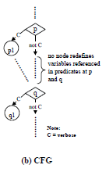
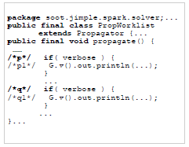
Detecting large number of infeasible paths through recognizing their patterns
Identical/complement-decision pattern :

Slide 4
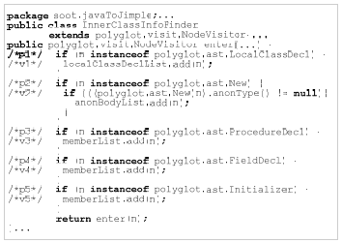
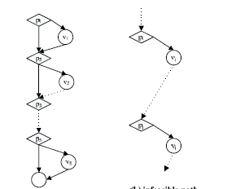
Mutually-Exclusive-Decision Pattern :

Slide 5
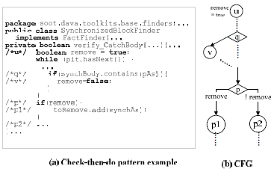
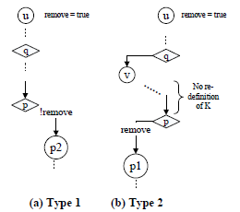
Check-then-do Pattern :

Slide 6
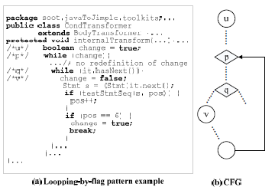
Looping-by-Flag Pattern :

Slide 7
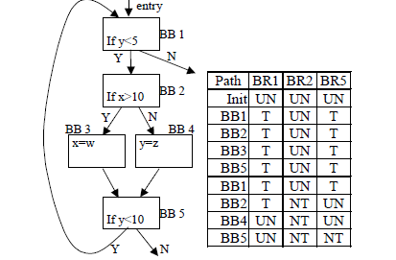
Using Branch Correlation to Identify Infeasible Paths for Anomaly Detection

Slide 8
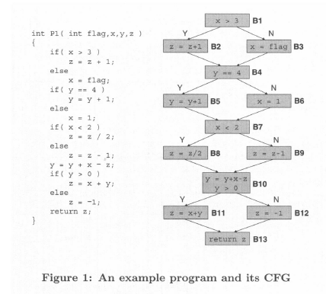


Efficient detection and Exploitation of infeasible paths for software timing analysis

Slide 9
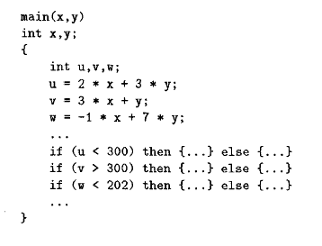
Detection of Infeasible Paths using Presburger Arithmetic

Slide 10
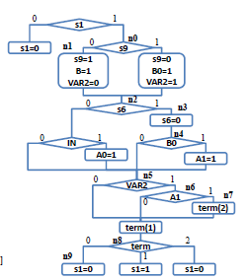
Systematic classification and detection of infeasible paths for accurate WCET analysis of Esterel programs
Convert code into C and draw control flow graph.
Four Patterns :
1. Emit and test signals
2. Termination and preemption
3. Encoding tick transitions
4. Sequentialization of concurrency
of a tick

Slide 11
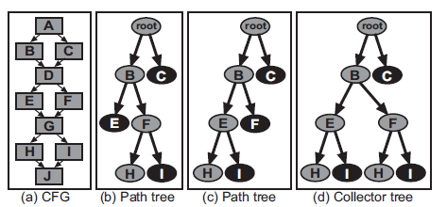
Automatic Derivation of Loop Bounds and Infeasible Paths for WCET Analysis using Abstract Execution
Collector tree :
Abstract extraction
Calculate loop bounds and infeasible paths

Slide 12
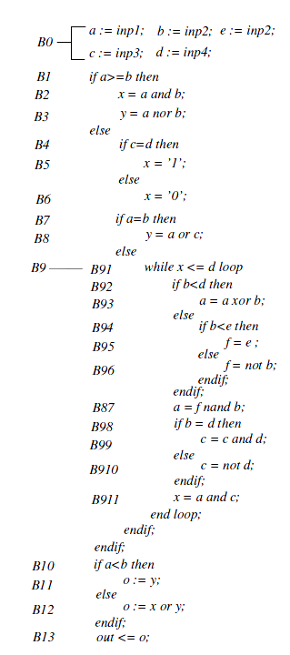
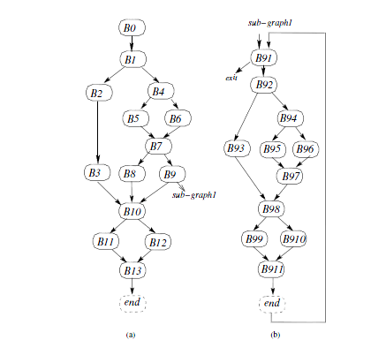
Performance Validation Through Implicit Removal of Infeasible Paths of the Behavioral Description
Basic blocks proceeding the loops
Basic blocks inside the loop
Basic blocks after loop

Slide 13

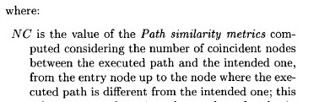
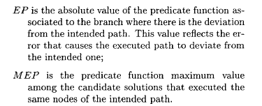
Identification of Potentially Infeasible Program Paths by Monitoring the Search for Test Data

